Slide 1
GeoFluids 2020
Management Summary
Peter Flemings
Jack Germaine
Maria Nikolinakou
Led by the University of Texas and partnered with Tufts University.

Slide 2
UT GeoFluids
Develops transformative algorithms and workflows to predict stress, pore pressure and fracture gradient
  Members apply these approaches in well construction to improve efficiencies
Studies deformation of mudrocks at high stress
  Members use resultant databases to improve well bore stability and update in-house software
Demonstrates practical approaches through field studies.

Slide 3
Overview
10 year program (2019-2028).
Can be terminated any time with no penalty.
1st payment of $50K due in May 2019 ($14,100 less than current cost).
Members who enter after Year 1 (2019) pay 1 year buy-in.
Led by University of Texas and partnered with Tufts University.
10 year record of research that impacts drilling and exploration.
Current members: Anadarko, BHP, BP, Chevron, ConocoPhillips, ExxonMobil, Hess, Pemex, Repsol, Shell, Equinor.

Slide 4
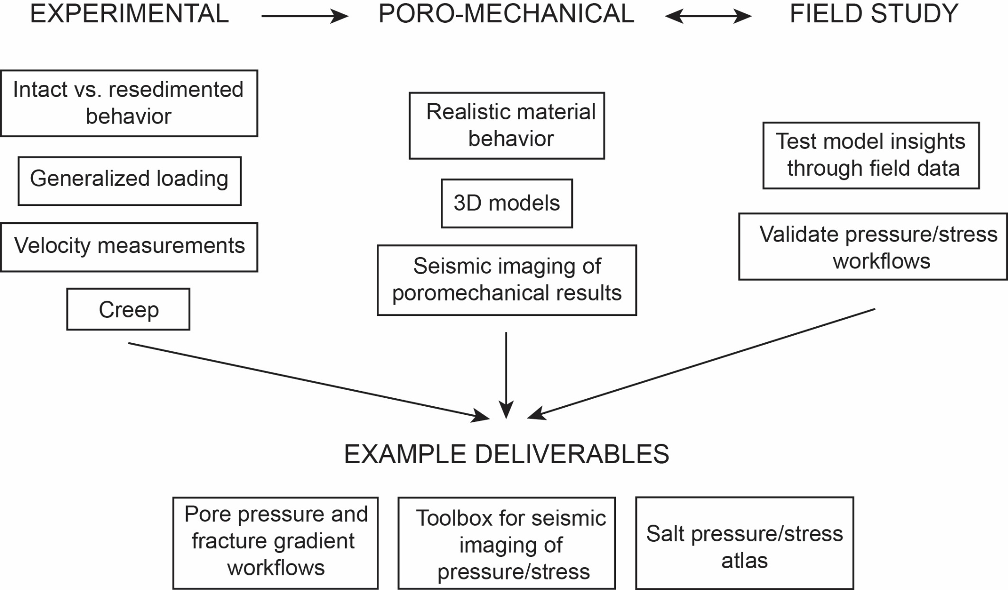
Research Plan

Slide 5
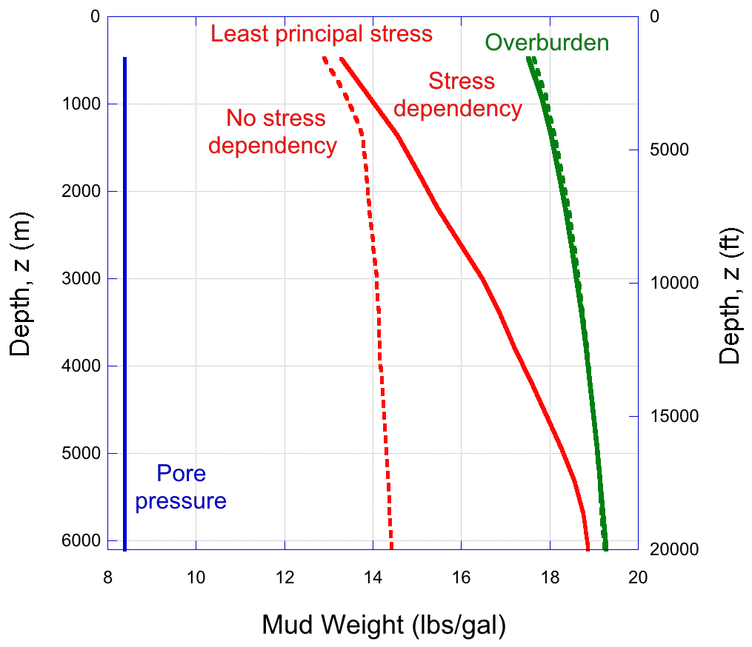
Example experimental impact
New model formulated from experimental results describes how fracture gradient varies with effective stress and lithology. This results in wider drilling window.
Approach already used by industry to reduce number of casing strings.

Slide 6
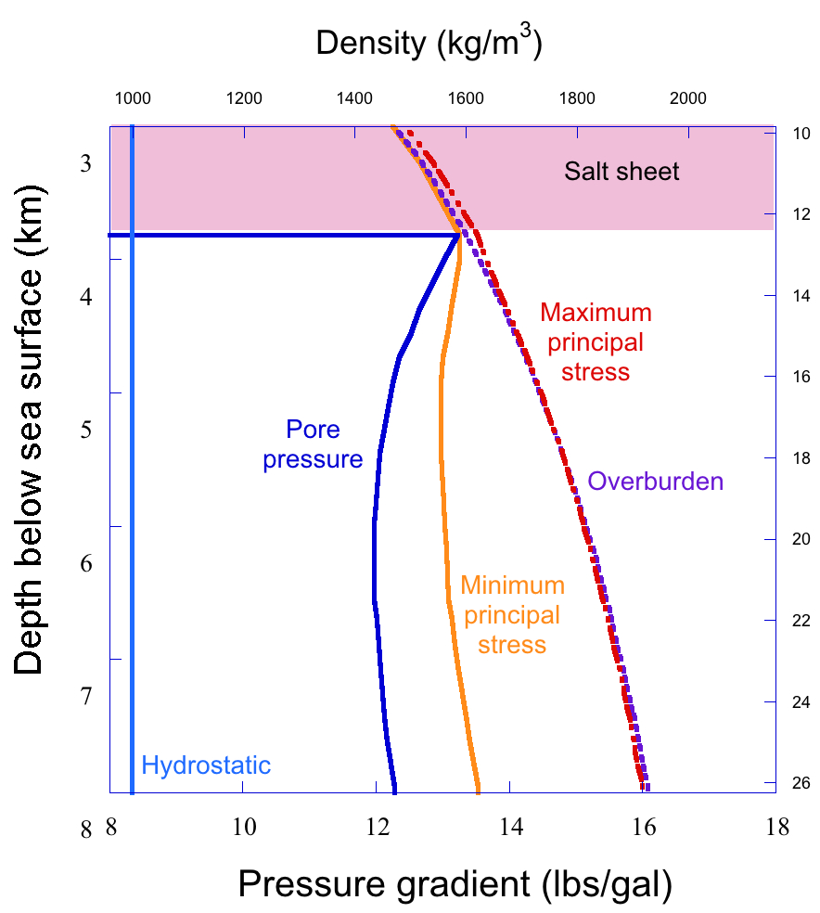
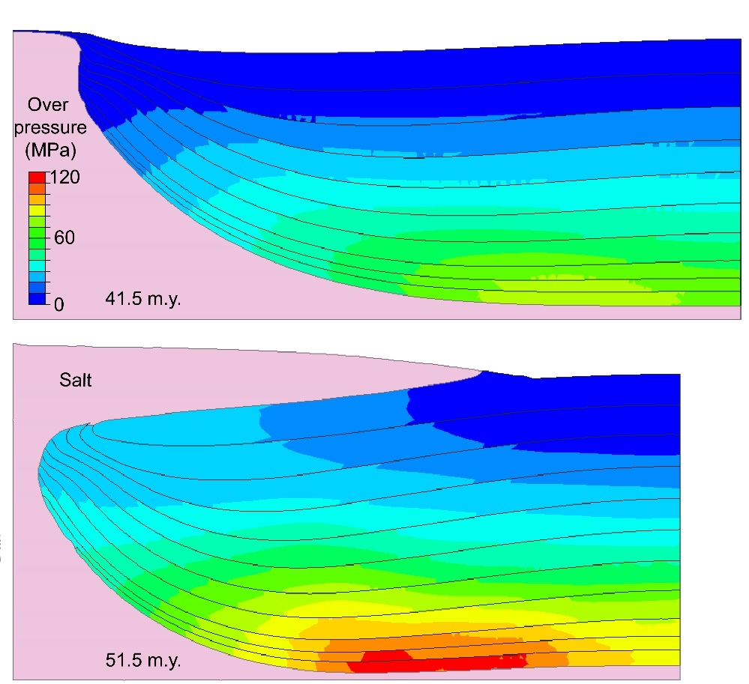
Example poromechanical impact
Nikolinakou et al, 2018, JMPG
Poromechanical prediction of pressure and stress ahead of the drill bit impacts design of well trajectories and evaluation of trap integrity.
Modeling resulted in better drilling decisions.

Slide 7
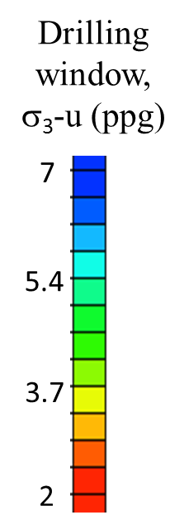
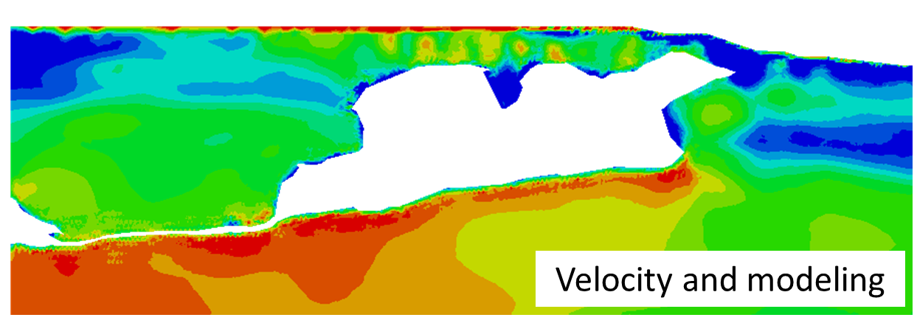
Example poromechanical and field-study impact
Heidari et al; Geophysics; in press
New patented workflow couples velocities with poromechanical modeling and improves pressure and stress prediction.
Several companies have improved their pressure prediction routines by incorporating this workflow.

Slide 8
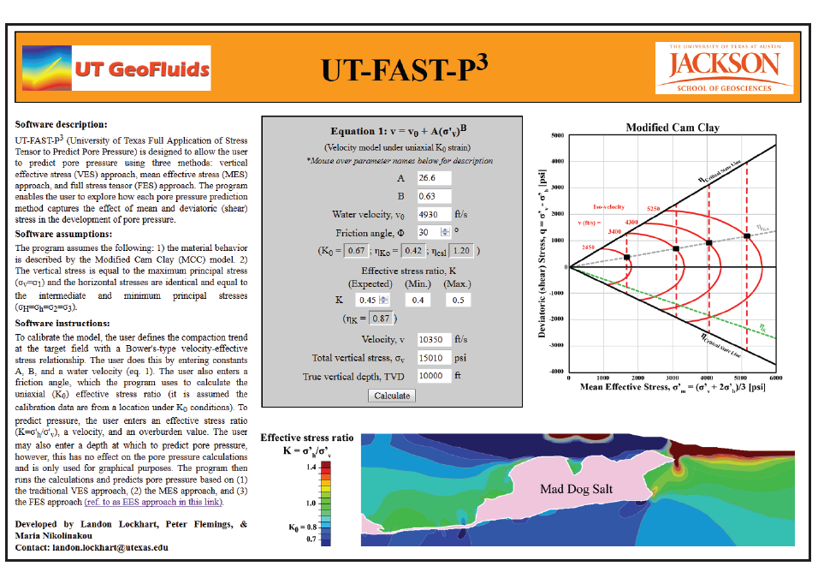
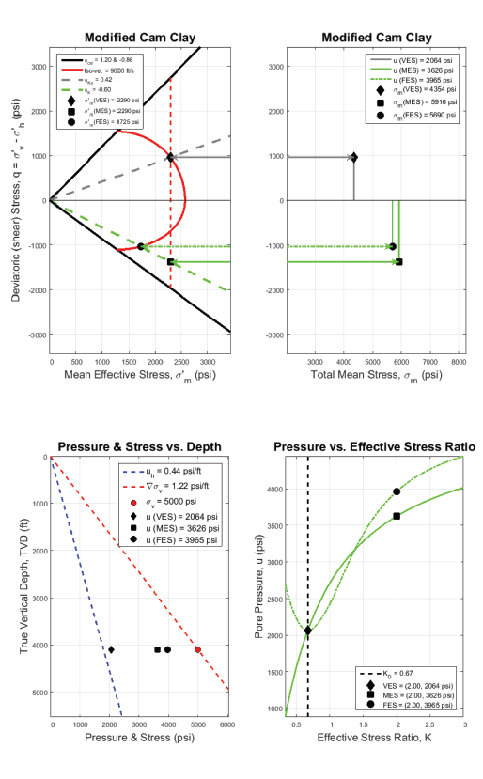
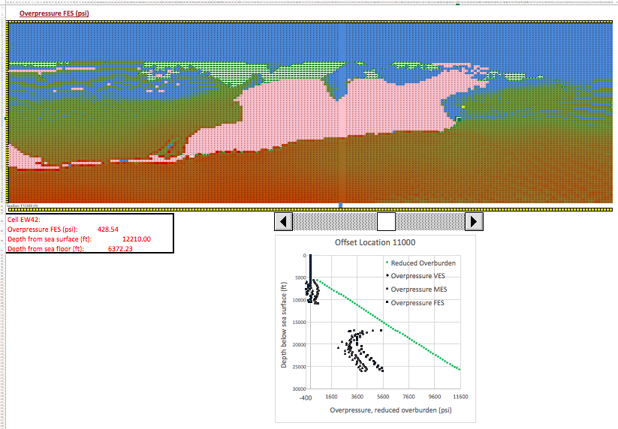
Example deliverables of UT GeoFluids
Members can access online tools for quick stress estimation, pressure prediction.
Modeling results are available in standard industry software format.

Slide 9
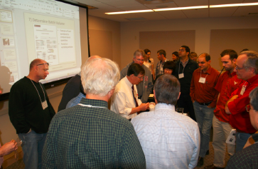
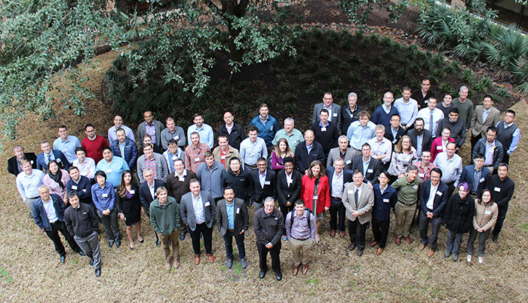
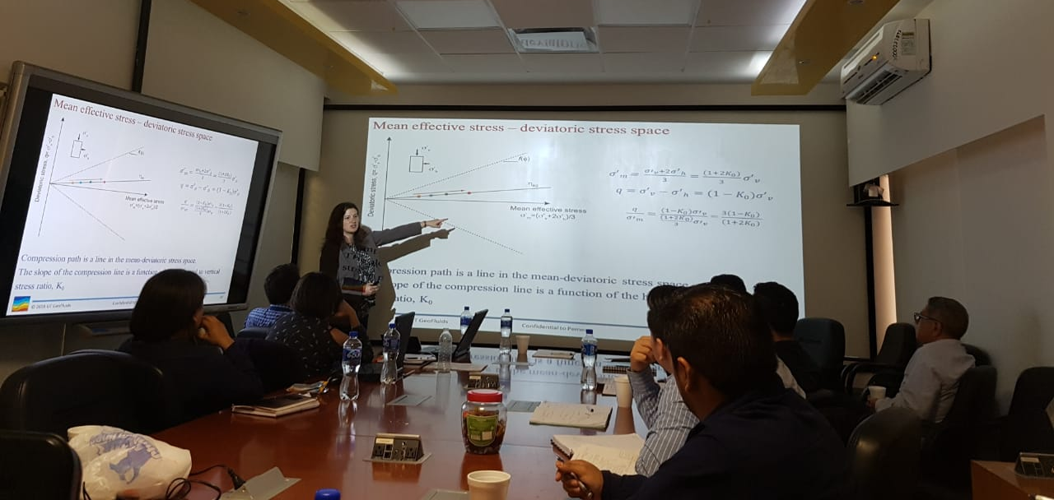
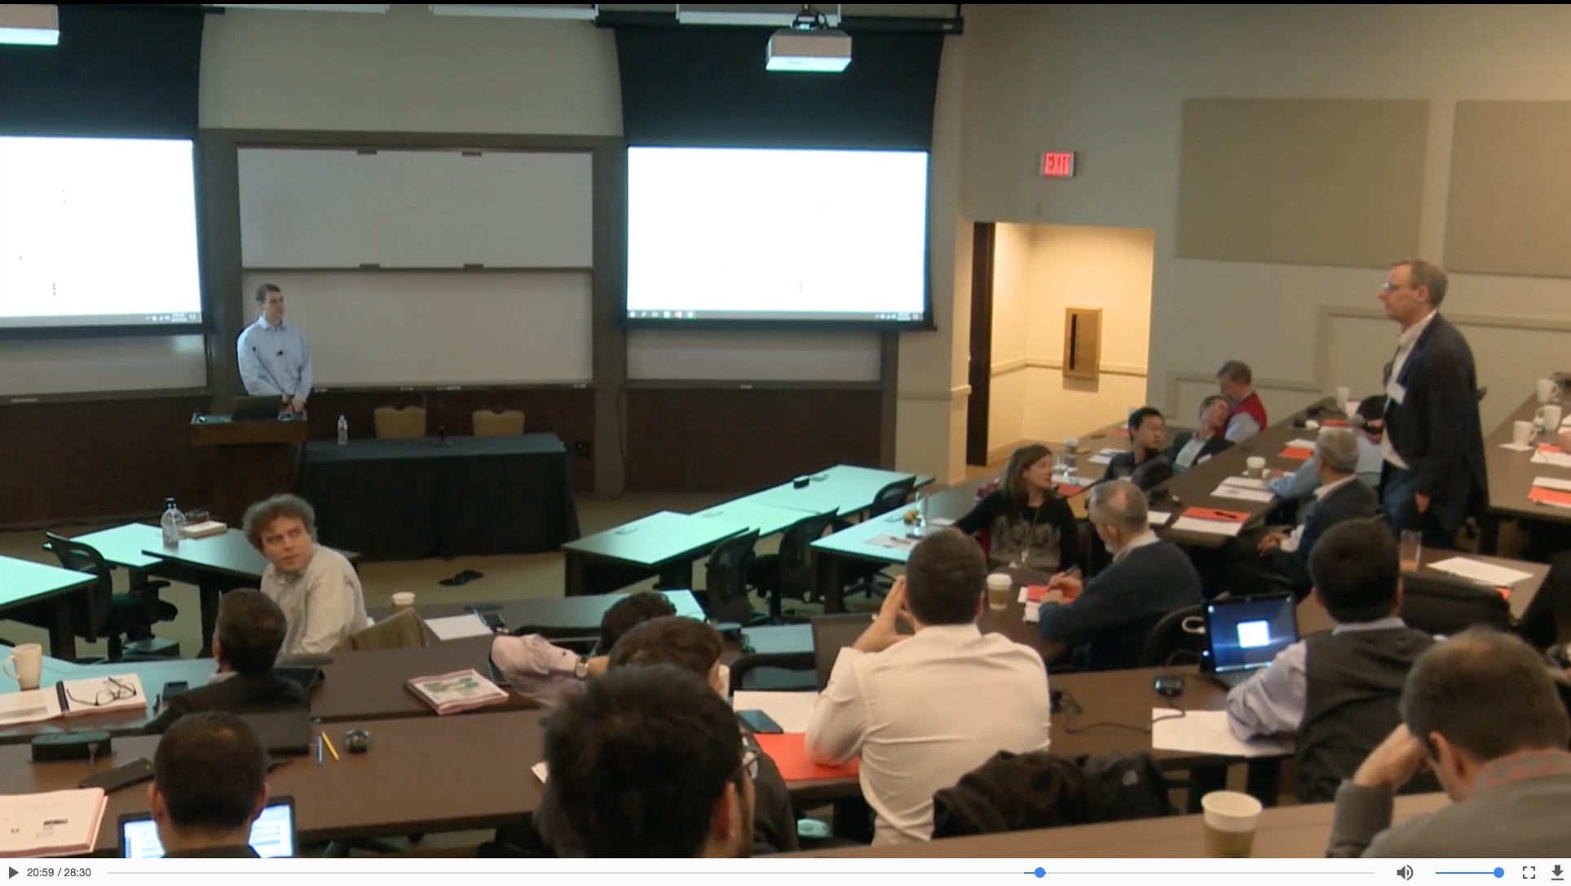
Example benefits of UT GeoFluids
Hands-on workshops
Annual meeting
Company visits
Meetings and discussions available online
Community exchange ideas and experience during meetings and workshops.
Technology transfer through annual meeting, company visits, website.

Slide 10
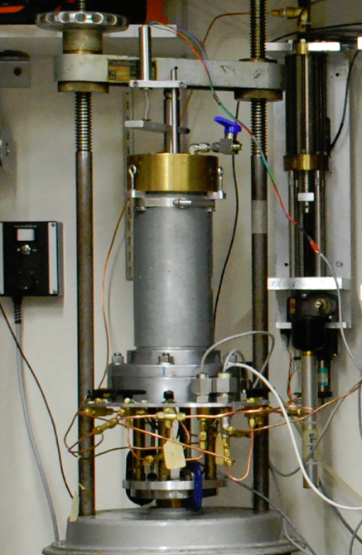
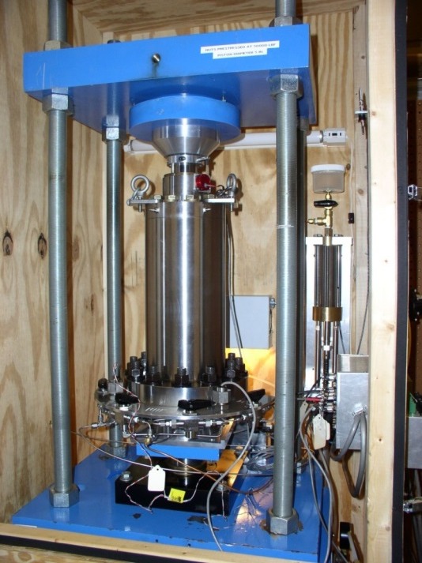
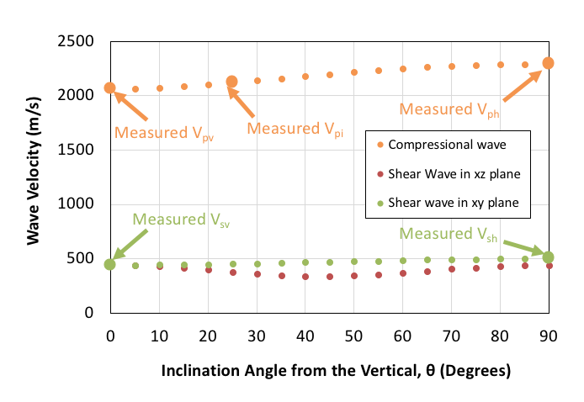
Future experimental impact
Continuing effort to build database of fundamental material behavior will provide resource for input into industry whole-earth models.
< 6,000 psi
< 15,000 psi
Measurements of velocity anisotropy with stress level will improve rock-physics models, imaging and pressure prediction.

Slide 11
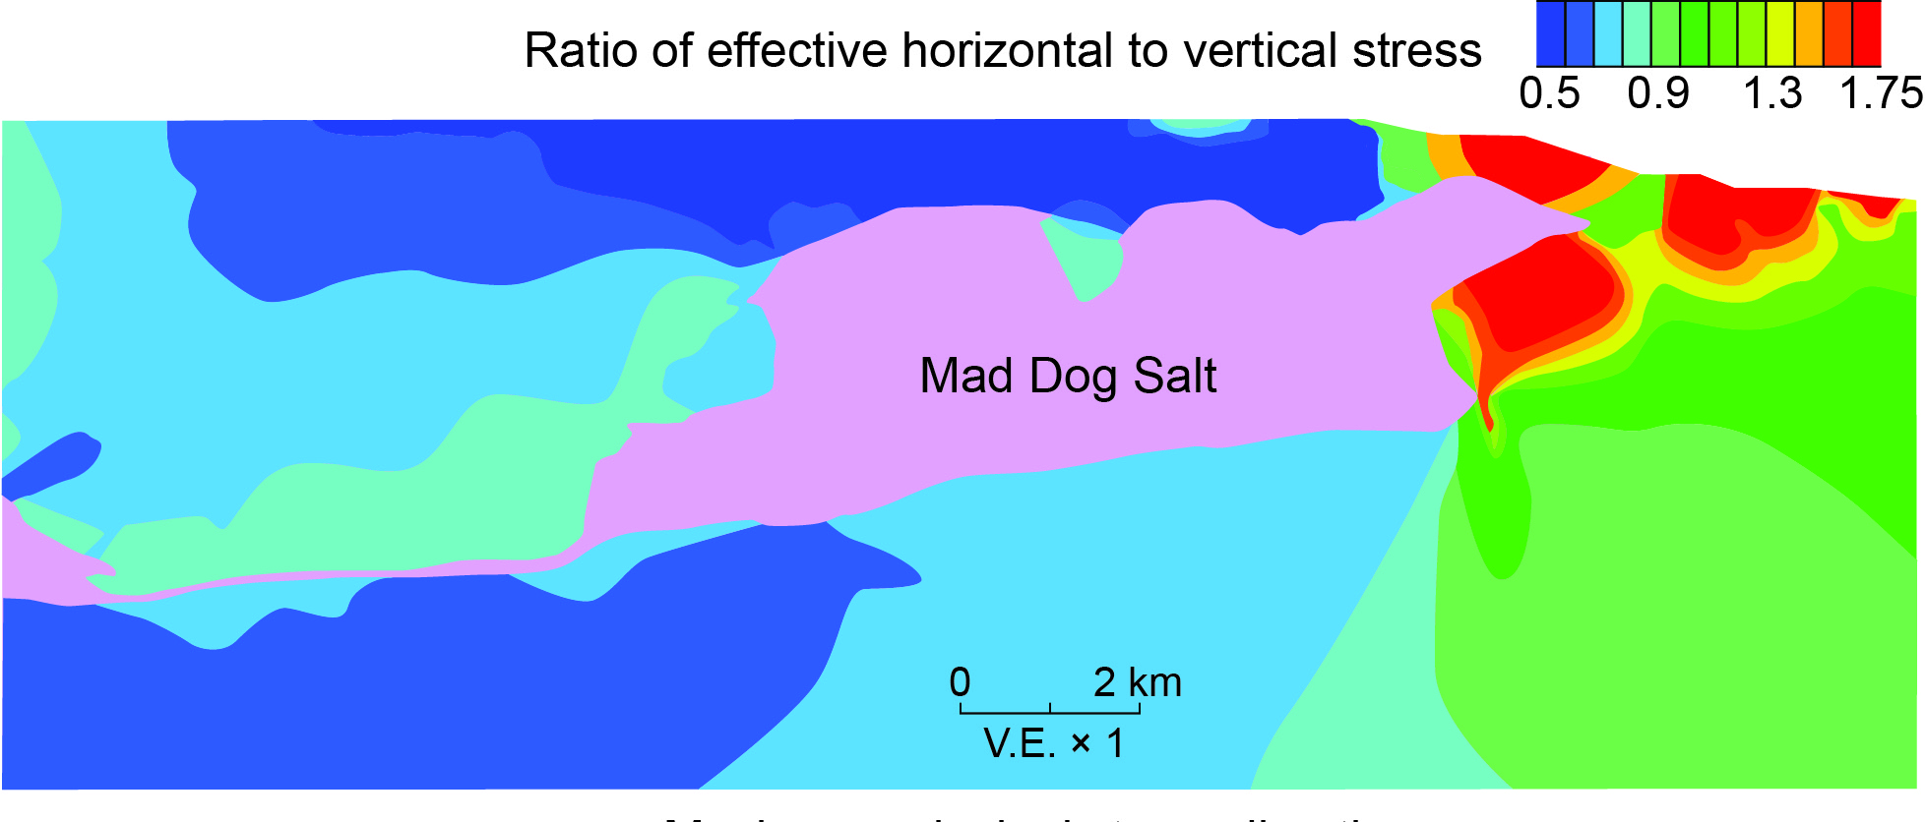
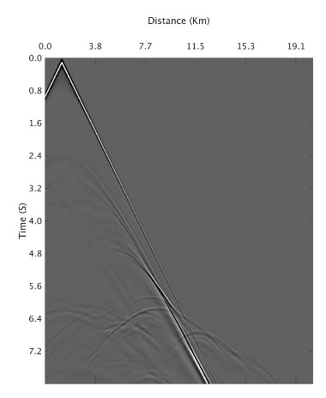
Future impact: improve seismic imaging and pressure prediction
+
+
Lab
measurements
Poromechanical results
Synthetic shot gathers
Anisotropic velocity (CIG) models
Synthetic
seismic
image
Coupling experiments, poromechanics, and reflection seismology will improve both seismic imaging and pre-drill pressure & stress prediction. This will improve imaging of exploration targets and well design.

Slide 12
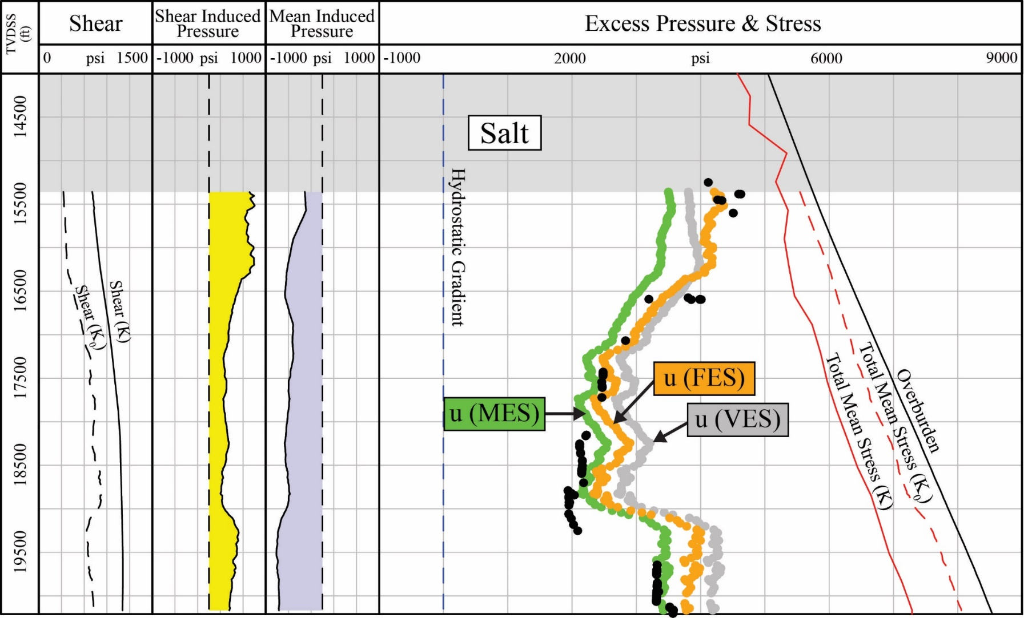
Future impact: insights applied to field studies
Validation of poromechanical predictions with field data will improve whole-earth models, pre-drill estimates and wellbore design.

Slide 13
Future impact: UT GeoFluids In Unconventional Basins
Physical models and field studies will illuminate how unloading impacts stress and pore pressure
Pore pressure workflow for unconventional basins will document differences from conventional approach, guide exploration decisions and improve well/completion designs.
(Kozlowski et al. 2018)

Slide 14
Key points
$50,000/yr is equivalent to ~60-90 minutes of offshore rig operations.
UT GeoFluids is the leading organization in the world integrating lab measurements, poromechanics, basin modeling, and pore pressure.
This unified approach results in whole earth models that improve trap evaluation, well design and reduce lost time.
Coupling poromechanics with reflection seismology may result in breakthrough advances for seismic imaging and pressure prediction.
Annual meeting and conferences provide industry SME to share knowledge.

